Slide 1


Kafka producer

Slide 2
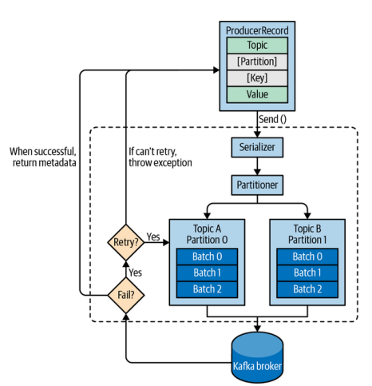

Slide 3
If a valid partition number is specified, that partition will be used when sending the record.
If no partition is specified but a key is present a partition will be chosen using a hash of the key.
If neither key nor partition is present a partition will be assigned in a round-robin fashion.

Slide 4
- send() have 2 options:
- synchronous ( lock thread, more reliable, longer latency, less throughtput )
- asynchronous ( non-block thread, low latency, high throught put , have callback onAck to know it sending success )

Slide 5
Configure Producer
acks:
0: not receive ack from leader broker
1:

